Slide 1
Jennifer Cooper
Fundraising Director
jcooper@floridalegion.org
FUNDRAISING FOR NON-PROFITS
Inspired by “The 5 Keys to Successful Fundraising” by Sandra Sims
www.floridalegion.org

Slide 2
Keys to Successful Fundraising
Building a Team
Choose the Right Fundraiser
Stay Organized
Follow Through
Raffles
Post Fundraising Opportunities
www.floridalegion.org
Notes:
Inspired by materials received at Rollins

Slide 3
Building A Team

Slide 4
Building A Team
Recruit Volunteers
Assign Roles and Responsibilities
Tap into skill sets, relationships or connections
www.floridalegion.org
Notes:
Committees lighten the load and distributes duties among several people

Slide 5
Building A Team
Effective Teamwork:
Need a leader
Define each person’s role or responsibility
Communicate often!
www.floridalegion.org

Slide 6
Develop Committees
Admin/Logistics
Sponsorships / Ticket Sales
Entertainment
Auction / Raffle
Volunteers
Finance
Marketing / Social Media
www.floridalegion.org

Slide 7
Sponsors / Donors
Donations and corporate sponsors
Donated items are budget relieving
Post Vendors are excellent prospects
Reach out to local businesses
Use your sphere of influence
www.floridalegion.org

Slide 8
Choose the Right Fundraiser

Slide 9
The WHY
Post needs money to stay in business
Personal motivation
Specific goal you’re working towards (i.e., Send 10 boys to Boys State, fund Post repairs)
For charity – Do your research!
www.floridalegion.org
Notes:
1. We all know dues does not fund everything
3. something you’re passionate about, or fill a need of the Post (i.e. a member’s house burned down)
4. Know the ins and outs of the charity. What is their mission or how they help the community. Take a tour of the organization or talk to someone.

Slide 10
The WHY
People give to:
Things they relate to
Personal connections
Emergencies (i.e., Hurricane damage, house fires, etc.)
Interest in improvements or additions
Recognize the brand / mission
In memory or honor of
www.floridalegion.org

Slide 11
Choosing the Right Fundraiser
Find something unique but familiar
What resources or connections do you have?
Who’s your audience? What are their interests?
Capture the spirit of your Post
www.floridalegion.org
Notes:
What would they attend or what are their interests?
If your community is already into cornhole, then a Cornhole Tournament might make sense. But if no one has ever heard of cornhole … that’s not the right fundraiser for you.

Slide 12
Stay Organized

Slide 13
Stay Organized
Create goals (important)
EX: money raised, new members, sell tickets
Set a budget
Determine if you can support up-front cost
Anticipate how much you could raise
Identify true cost of event
See cost to profit ratio throughout planning process
www.floridalegion.org

Slide 14
Stay Organized
Creating a budget
Revenue (ticket sales, sponsorship, raffles, etc.)
Expenses (food, location, parking, supplies, etc.)
If expenses exceed revenue, is it worth having the event?
www.floridalegion.org
Notes:
TRICK QUESTION – maybe! Depends on what your goals are for the event. INVESTMENT?

Slide 15
Stay Organized
Income
Expenses
Item | Amount
Ticket Sales | $250
Sponsorships | $1,500
Auction | $600
50/50 Raffle | $300
TOTAL | $2,650
Item | Amount
Entertainment | $300
Printing Costs | $100
Decorations | $150
Food | $500
TOTAL | $1,050
www.floridalegion.org

Slide 16
Stay Organized
NET = $1,600
Cost Profit Ratio – 60%
www.floridalegion.org
Notes:
Is it worth having this event? TRICK QUESTION – depends on what goals you set to accomplish.

Slide 17
Stay Organized
Develop a Timeline
Start at event date, or deadline and work backwards
Include major and minor details (check list)
Set deadlines for when things need to be done
Check in periodically to stay on track
www.floridalegion.org

Slide 18
Follow Up

Slide 19
Follow Up
CELEBRATE!
Present proceeds to beneficiary
List accomplishments
Share stories
Complete budget with actual expenses & revenue
www.floridalegion.org

Slide 20
Follow Up
EVALUATE
What worked?
What needs improvement?
How can you make it better?
www.floridalegion.org

Slide 21
Follow Up
SAY THANK YOU
Letter / Personal note
Recognize during event, present award
Print on event materials
Meaningful gift or story on their impact
www.floridalegion.org

Slide 22
Raffles

Slide 23
Raffles : Disclaimer
We are NOT attorneys,
BUT…
www.floridalegion.org

Slide 24
Raffles
RAFFLES
MOST raffles, lotteries, or games of chance are considered gambling and are illegal
Exception for qualifying nonprofits (our loop-hole)
www.floridalegion.org
Notes:
- we just have to adhere to certain rules

Slide 25
Raffles
RAFFLES – Fees / Pricing
NO fees = can not say someone is required to pay for event/raffle ticket
Violation – “Tickets cost $100”
Correct – “a suggested donation for a ticket is $100”
www.floridalegion.org

Slide 26
Raffles
RAFFLES – Materials
Must properly display following information on EVERY brochure, advertisement, entry form, etc.
Source of funds used for award prizes
Date, hour and location where the winner is selected
Outline rules and regulations governing contest
Name group/business who will benefit from proceeds
www.floridalegion.org
Notes:
No literature or advertisement may be misleading, false, or deceptive.

Slide 27
Raffles
RAFFLES – Winners
Must be selected at random
Illegal to remove, disqualify, reject, or otherwise discriminate based on whether the entrant paid or not
No minimum number of tickets
All prizes must be awarded
Winners must be notified in a timely manner
www.floridalegion.org
Notes:
Can’t require X number of tickets to win

Slide 28
POST OPPORTUNITIES

Slide 29
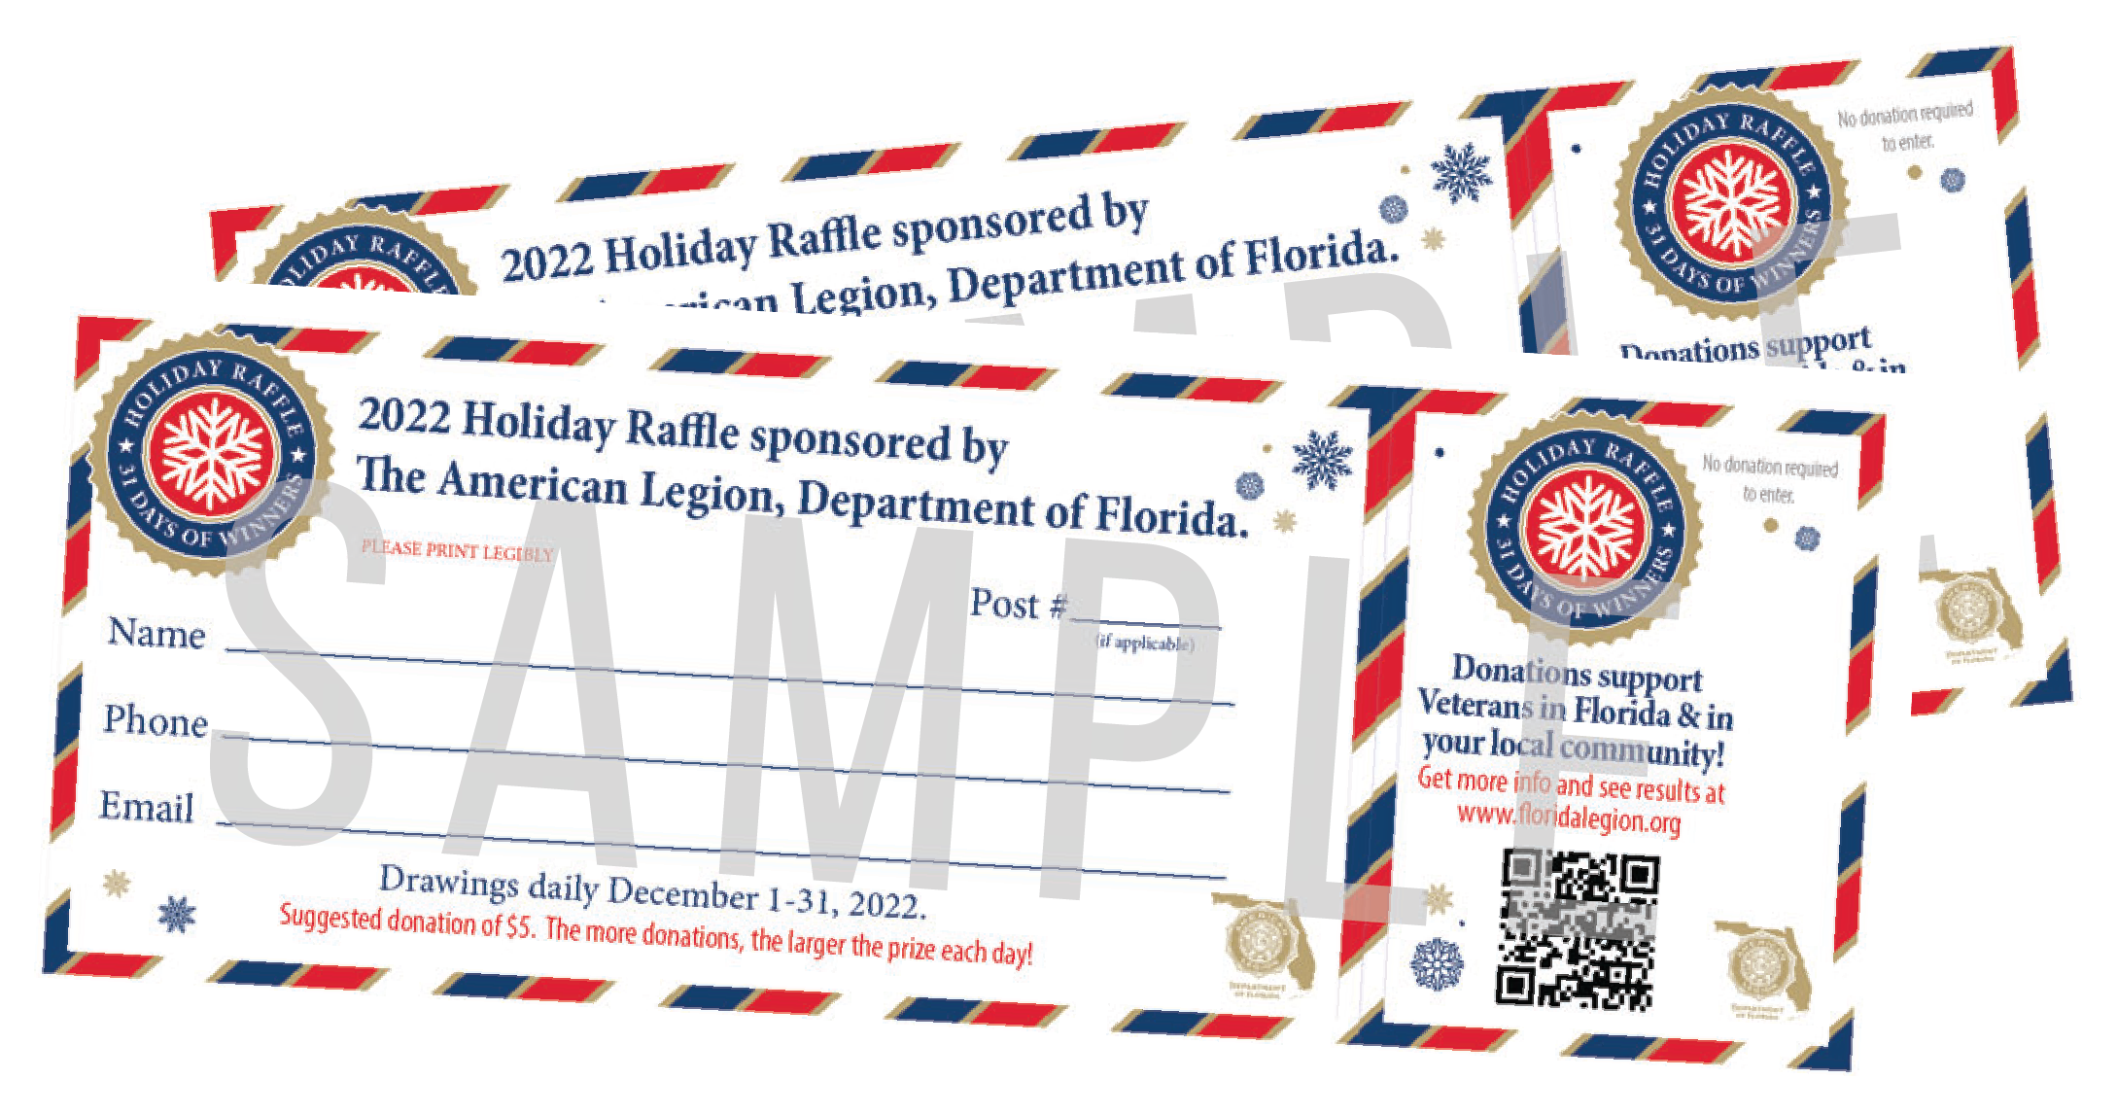
Holiday Raffle
ABOUT THE RAFFLE:
31 Winners selected in Dec
Tickets = $5 suggested donation*
Prize pot
Ticket sales
www.floridalegion.org
Notes:
TICKETS – FREE option is available online, which requires mail-in submission.
PRIZE POT - $1 from every ticket sold for a donation will go into the prize pot. The remaining $4 will be divided between Department and participating posts. The accumulated prize pot is divided by percentages for each day in Dec.
Daily ticket sales in Dec will go toward next-day prize payout
SALES – exclusively sold at participating posts starting Sept 1 through Oct 31. Then, available online starting Nov 1. Tickets can still be sold at the Posts through Dec 30, 2023.

Slide 30
Holiday Raffle
*If 10,000 raffle tickets are sold across the state, the total raffle prize pool starts at $10,000 and the first payout would be $500!
PRIZE POT:
Dec 1 – 5% Dec 2 – 2% Dec 3 – 1% Dec 4 – 2% Dec 5 – 1% Dec 6 – 2% Dec 7 – 7% Dec 8 – 1% Dec 9 – 2% Dec 10 – 1% Dec 11 – 3% Dec 12 – 1% Dec 13 – 2% Dec 14 – 1% Dec 15 – 7% Dec 16 – 1%
Dec 17 – 2% Dec 18 – 10% Dec 19 – 3% Dec 20 – 1% Dec 21 – 2% Dec 22 – 3% Dec 23 – 3% Dec 24 – 5% Dec 25 – 10% Dec 26 – 5% Dec 27 – 1% Dec 28 – 3% Dec 29 – 2% Dec 30 – 1% Dec 31 – 10%
www.floridalegion.org

Slide 31
Holiday Raffle
POST PARTICIPATION:
Posts preorder tickets for $3/ticket and sell for a suggestion donation of $5/ticket. POSTS KEEP ALL PROCEEDS!
Exclusivity at participating Posts through Oct 31st
Posts can still receive credit for online tickets
Department provides materials and promotion
www.floridalegion.org

Slide 32
Holiday Raffle
WHY POSTS SHOULD JOIN:
More funding for Post
Ability to support Florida’s veterans at a higher level
Chance to engage the local community or bring in new members
Department helps with materials and promotion
It’s just plain FUN!
www.floridalegion.org

Slide 33
Rafflebox
ABOUT:
State-wide online 50/50 raffle drawings
Posts can participate and receive a percentage of the proceeds
Posts will get a special link/QR Code to promote ticket sales
Department will manage the drawings, licensing, winner payouts, and tax filings
Monthly/Quarterly distributions will be paid to the Dept for efforts
*Pending a successful DEC vote this afternoon
www.floridalegion.org
Notes:
GEO-Fenced so only able to sell tickets to IP addresses located within the state of Florida. (compliancy)

Slide 34
DISCUSSION QUESTIONS
www.floridalegion.org

Slide 35
What are the challenges you face when trying to do a fundraiser?
www.floridalegion.org
Notes:
People lose interest
Do not have the resources
Not sure what we’re doing or where to start

Slide 36
How can you motivate other members?
www.floridalegion.org
Notes:
Find out what they like to do
Why they joined the Legion
What they’re passionate about

Slide 37
What challenges do you have when working as a team?
www.floridalegion.org
Notes:
Don’t get along
Have someone who just wants the title and not do the work
Lack of communication = duplication of tasks or things not getting done

Slide 38
How can you ensure your fundraiser stays on track?
www.floridalegion.org
Notes:
Budget and timeline
Hold people accountable

Slide 39
Questions?
www.floridalegion.org

